Slide 1
Welcome
IGCSE Information Session

Slide 2
IGCSE Information Session
Cambridge IGCSE is the world’s most popular international qualification for 14 to 16 year olds.
It is recognised by leading universities and employers worldwide, and is an international passport to progression and success.
Developed over 25 years ago, it is tried, tested and trusted by schools worldwide.

Slide 3
IGCSE at ACS (International)
IGCSE Results | 2013 | 2014 | 2015 | 2016 | 2017 | 2018 | 2019
Pass Rate % | 90 | 91 | 92 | 92 | 95 | 92 | 93
Distinction % | 45 | 48 | 53 | 50 | 57 | 49 | 53
Distinction refers to students who achieve an A or A* in their studies.

Slide 4
IGCSE – Top in the World
”Top in the World refers to the learner who had gained the highest standard mark in the world for a single subject.”
ACS (International) Top in the World Achievements
2019 Additional Mathematics (3)
2018 English Literature
2016 Additional Mathematics, Chemistry, Chinese (2)
2015 Mathematics & Economics
2014 Physical Education
2013 Mathematics (2), Economics
2012 English Literature
2011 A Mathematics, Chinese
2010 A Mathematics, Chinese, Mathematics, English Language
2009 Geography, Chinese

Slide 5
IGCSE Structure
To complete their IGCSEs, students complete 7 or 8 subjects over two years.
Compulsory Subjects
English Language (or English as a Second Language for non-native speakers)
Mathematics
A second language (currently studying in Year 2)
A science subject
A humanity subject
Option Subjects
Students choose a further three subjects from Options 1, 2 and 3.
Pre-IG students only choose two subjects from Option 1 and Option 3.
Students also complete one Physical Education lesson per week.

Slide 6
IGCSE - Subjects
Compulsory Humanities | Compulsory Science | Option Subject 1 | Option Subject 2 | Option Subject 3
History | Biology | Biology | Business Studies | Biology*
Geography | Chemistry | Chemistry | Economics | A Mathematics
Business Studies | Physics | Physics | A Mathematics | Music
Economics |  | Spanish | Global Perspectives | Art
Global Perspectives |  | Geography |  | Drama
 |  | Literature |  | IGCSE PE
 |  |  |  | Literature
*Triple Science students must pick Biology in Subject 3

Slide 7
Mother Tongue
For Singaporean students
All Singaporean students must take their Mother Tongue language.
If you have been granted an exemption by MOE, the school MUST be given a copy of the exemption letter in order for you to choose another language.

Slide 8
IGCSE Languages
ESOL is not an open option for mainstream students. Approval must be gained from the English Department.
Students from Pre-IGCSE must choose either Mandarin – Chinese or First Language Chinese.
Spanish in Option 2 is for complete beginners only and is designed for able language students who are interested in learning another language. If Spanish is studied at IGCSE level, the students cannot do Spanish Ab Initio IB, as the Ab Initio subjects are for beginners of that language. Spanish students can progress to Spanish B if they are able.
Singaporean students must take Mother Tongue unless they have an exemption.

Slide 9
Ab Initio
For language students
If you have studied a language before, including at IGCSE level, you cannot pick that language at the Ab Initio level in the IBDP
This means that if you plan to do an Ab Initio level at IB level you should not enroll in it for IGCSE.

Slide 10
IGCSE Restrictions
Additional Mathematics is dependent on Year 2 results and is approved on a case-by-case basis by the Mathematics faculty.
Students opting for triple Science and Additional Mathematics need to meet the requirements of both the Science and Mathematics Faculty.
Students cannot choose both Business Studies and Economics.
Students cannot choose both Geography and Global Perspectives.
The final decision concerning the option choices is subject to approval by the relevant Heads of Faculty and the Vice Principal based on past academic performance and the potential of the individual student.

Slide 11
IGCSE Subjects

Slide 12
Mathematics
Mathematics faculty offers two courses in the IGCSE programme, namely
International Mathematics (0607)
Additional Mathematics (0606)
Mathematics at the IGCSE level focuses on developing mathematical concepts and skills that can be applied to real-life situations using appropriate technology.
Faculty has experienced IGCSE teachers and we have produced many top of the world students in mathematics.
We ensure appropriate placement of students into additional mathematics course so that it is both rigorous and rewarding experience for students.

Slide 13
Mathematics
 | International Maths (Years 1 to 4) | Additional Maths (Year 3 and 4)
Entry Criteria | A pass in the end of year exams or equivalent qualification | At least a grade B in the end of year 2 exams or 75% in the diagnostic test
For whom | Compulsory for all students | Students who want to pursue courses in Mathematics, Engineering, Economics and other math related courses
Students need to enrol in Additional Mathematics in order to do Math HL in IB
and number of math related courses at university
Therefore you need to make careful decision of your subject choices as you won’t be able to change after subject option period is over.

Slide 14
English Language (Compulsory)
Paper 1 Reading (2 hours) 80 Marks = 50% of the total marks | Paper 2 Directed Writing and Composition (2 hours) 80 Marks = 50% of the total marks
Structured and extended writing questions. Questions will be based on three reading texts. | Extended writing question and a composition task.

Slide 15
English Literature (Optional)
2019: ACS (International) A*/A= 61%
Paper 1: Poetry and Prose 1 hour 30 minutes 50 Marks = 50% total | Paper 3: Drama 45 Minutes 25 Marks = 25% total | Paper 4: Unseen 1 hour 15 minutes 25 Marks = 25% Total
Candidates answer two questions on two texts: one poetry and one prose. There is a choice of two questions (one passage-based and one essay) on each text. | Candidates answer one question on one text. There is a choice of two questions (one passage-based and one essay) on each text | Candidates answer one question. There is a choice of two questions requiring critical commentary (one based on literary prose and one based on a poem or extract of a poem).

Slide 16
Science
The aim of IGCSE Science course is to provide through well-designed studies of experimental and practical science a worthwhile educational experience for all students. In particular, it enables pupils to acquire sufficient understanding and knowledge in Biology / Chemistry / Physics and develop attitudes relevant to this subject, such as concern for the health and the environment, objectivity, integrity, enquiry, initiative, inventiveness and an eye for detail. It also acts as a good foundation Science for pupils who intend to pursue International Baccalaureate programme in their further studies.

Slide 17
Science
Pupils can take Biology (0610), Chemistry (0620) and/or Physics (0625).
At the end of the course, pupils will sit for three Papers (Extended curriculum), obtaining grade A* to G.
Paper | Time | Marks | Weighting | Description
Paper 2 | 45 minutes | 40 | 30% | Compulsory multiple choice paper.
Paper 4 | 75 minutes | 80 | 50% | Extended theory paper Short and structured answers
Paper 6 (Practical) | 60 minutes | 40 | 20% | Alternative to Practical paper Written paper designed to test familiarity with laboratory based procedures

Slide 18
Triple Science Requirements
At least grade 6 for achievement reports
All year 2 students will be assessed on the tests, worksheets, coursework and projects through their module grade reports (achievement).
At least 80% of total marks scored in the EOY science exams (equivalent to minimum a high B)
All year 2 students will be tested on the entire year 2 science curriculum in the End-of-year science exams.
At least grade 6 for effort reports
All year 2 students will be assessed on their attitude of learning, conscientiousness in assignments & homework, desire & motivation for academic excellence through their module grade reports (effort).
Favourable recommendation
From science teachers teaching the student for the year and LSS coordinator
Triple science (IGCSE) group
2 HL Science (IB) groups
Subject to performance at IGCSE levels (At least grades B for both sciences)

Slide 19
Relevant Course Requirements
Engineering
Entry requirements vary significantly.
Math (HL) and Physics (HL) are required for some universities.
Math (HL) and Chemistry (HL) for chemical engineering, possibly Physics (HL) or (SL) as well.
Medicine
Chemistry and Biology at HL.
Physics may be accepted instead of Biology for some courses.
Some programmes have English and/or Math requirements as well.
Occupational Therapy/ Physiotherapy
Students would be expected to have Mathematics and at least one Science (Chemistry, Biology or Physics) at SL level.
Psychology, Science or related subjects
More than one HL Science subject and/or Math SL may be required.
Architecture:
Math and/or Physics at HL may be required.
Art may not be required but may be useful and you may need to present a portfolio.

Slide 20
Languages - ESOL
English As A Second Language
The syllabus aims to:
develop learners’ ability to use English effectively for the purpose of practical communication.
form a solid foundation for the skills required for further study and higher studies using English as the medium of instruction.
develop learners’ awareness of the nature of language and language-learning skills.

Slide 21
Languages - ESOL
In addition, ACS (International) English as a Second Language course offers learners the opportunity to:
Broaden their international perspective and develops their intercultural competences.
Consolidate their academic speaking and writing skills.
Develop key IB ATL (approaches to Teaching and Learning) skills necessary for the diploma programme.
Assessment:
Three assessment component.
All four key skills assessed (reading, writing, listening and speaking).
Externally assessed.
Recognised as equivalent B2 with the CEFR.
A or A* to do First Language English (Group 1) at IB

Slide 22
Languages - ESOL
Who is the course for?
Students who are not native speakers of English.
Students who use English as a Lingua Franca and/or as a language of instruction.
Students who have completed lower secondary education in English.
What IGCSE ESOL is not?
An easy option.
A beginner English course.
An English as a foreign language course.

Slide 23
Humanities
The Humanities faculty offers 5 courses in the IGCSE programme:
Geography (0460)
History (0470)
Business Studies (0450)
Economics (0455)
Global perspectives (0457)
All students must choose one Humanities subject. Students wishing to take two
Humanities subjects should have a love of writing and critical thinking.

Slide 24
Global Perspectives
Students will learn to see world events and challenges from various perspectives and think critically about the information you are given and acquire.
Students will gain important skillsets required for the IB.

Slide 25
Global Perspectives
Component | Description
Component 1 | Written Examination - long answer questions
Component 2 | Individual Report - 1,500 to 2,000 words
Component 3 | Team Project - Collaborative paper - 750 to 1000 words ) Personal Reflection - 750 to1000 words

Slide 26
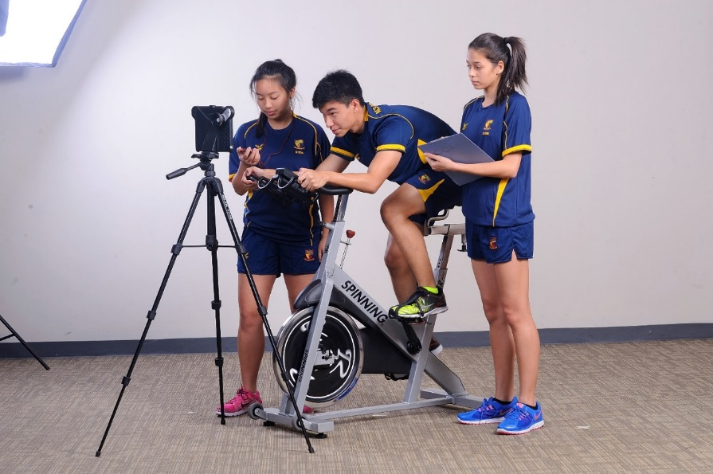
Physical Education
This exciting IGCSE course combines the traditional disciplines of human biology, health and diet with skill development and mastery across a range of sporting activities. This is an engaging and interactive subject.
“Do you need to be good at sports?” Yes
Students need to have a real interest in sports and be involved in competitive Sports CCAs either in or outside of school.
Students are assessed on their practical ability and so should be fit, healthy and willing to participate in competitive sports and exercise.

Slide 27
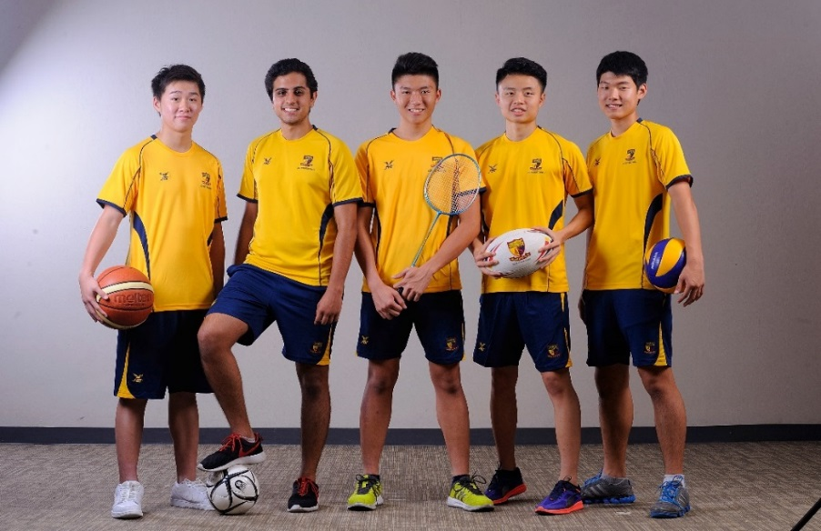
Assessment
50% Practical Performance- Candidates will be assessed on their performances across four different sporting activities. Performances are filmed and graded against performance assessment criteria specific to each sport.
50% Written Exam- One paper on the following topics of Physical Education including units on “Anatomy and Physiology”, “Health, Fitness and Training” and “Skill Acquisition and Psychology” and “Social, Cultural and Ethical Influences”.

Slide 28
Practical Assessment
Students must be assessed in four of the following sports.
Games | Gymnastic Activities | Dance | Combat Activities | Athletic Activities | Outdoor and Adventurous Activities | Swimming Activities
Football Badminton Baseball, Rounders Softball Basketball Cricket Golf Handball Hockey Lacrosse Netball Rugby League or Rugby Union Squash Table Tennis Tennis Volleyball | Artistic Gymnastics (Floor and Vault) or Rhythmic Gymnastics Individual Figure Skating Trampolining | Dance | Judo or Taekwondo | Cross-Country Running Cycling Rowing and Sculling Track and Field Athletics Weight Training for Fitness | Canoeing Hill Walking Orienteering Horse Riding Mountain Biking Rock Climbing Sailing Skiing or Snowboarding Windsurfing | Competitive Swimming Life Saving or Personal Survival Water Polo

Slide 29
The Arts/ 0410 Music
Eligibility & Criteria for selection
Students must already be learning & playing a Music instrument.
It is strongly recommended that students need to have attained at least a Grade 4 Music Theory & Practical certifications from the ABRSM or standard equivalent exam boards.
Students need to continue with their Music theory &
instrumental studies with their external music instructors
(paid for, at their own expenses).
Potential applicants may arrange to see the school’s
music teachers personally for more information.
Interested applicants who do not meet the criteria , may see Ms. Arleen Teo for an audition, or a discussion.

Slide 30
The Arts/ 0410 Music
Component | Time | Marks | Weighting | Description
1 Listening | 1 hour 15 minutes | 70 | 40% | Written examination based on CD recordings supplied by Cambridge International Externally assessed
2 Performing |  | 50 | 30% | Two prepared performances, one individual and one ensemble Internally marked/externally moderated
3 Composing |  | 100 Scaled to 50 | 30% | Two contrasting compositions Internally marked/externally moderated

Slide 31
The Arts/ 0411 Drama
Component | Time | Marks | Weighting | Description
1 Written examination | 2 hours 30 minutes | 80 | 40% | all questions in Section A two questions in Section B (one compulsory question and one question from a choice of two) both questions in Section C.
2 Coursework |  | 120 | 60% | Submit three pieces of practical work: • individual performance based on an extract from a play • group performance based on an extract from a play • group performance based on an original devised piece. Internally assessed and externally moderated
Adapted from Elliot Eisner

Slide 32
The Arts/ 0400 Art and Design
Component | Time | Marks | Weighting | Description
1 Coursework |  | 100 | 50% | Research, develop and realise a project from one area of study in the subject content from a theme set by the teacher. Two parts to the coursework: – a portfolio and – a final outcome. Externally assessed
2 Externally set assignment | 8 hours | 100 | 50% | Respond to one starting point set by CAEI Produce work from the same area of study as Component 1, but they do not have to. Two parts to the assignment: – supporting studies and – a final outcome, produced during a supervised test of 8 hours’ total duration. Externally assessed

Slide 33
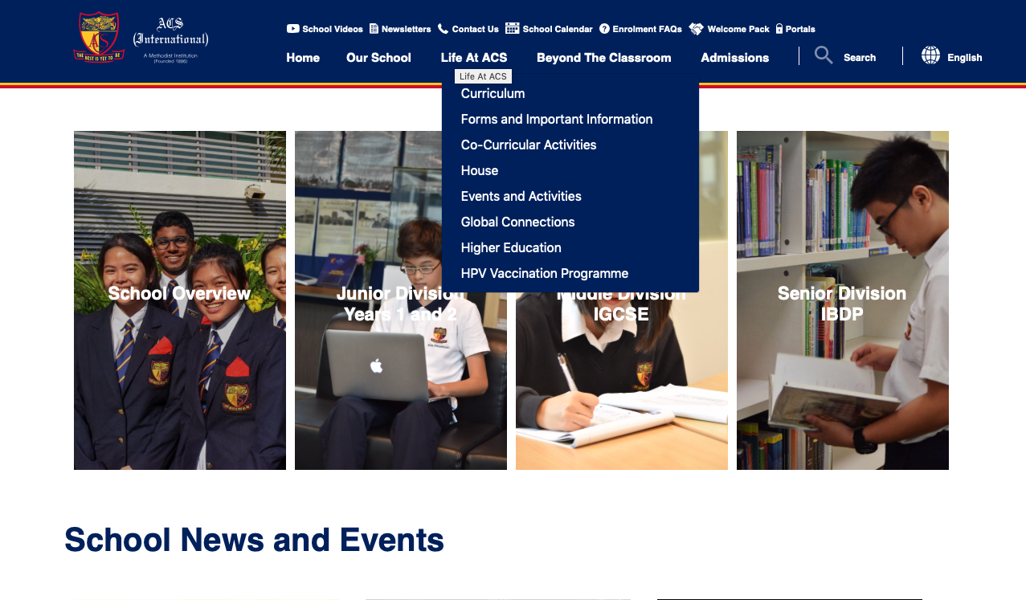
Information Booklet

Slide 34
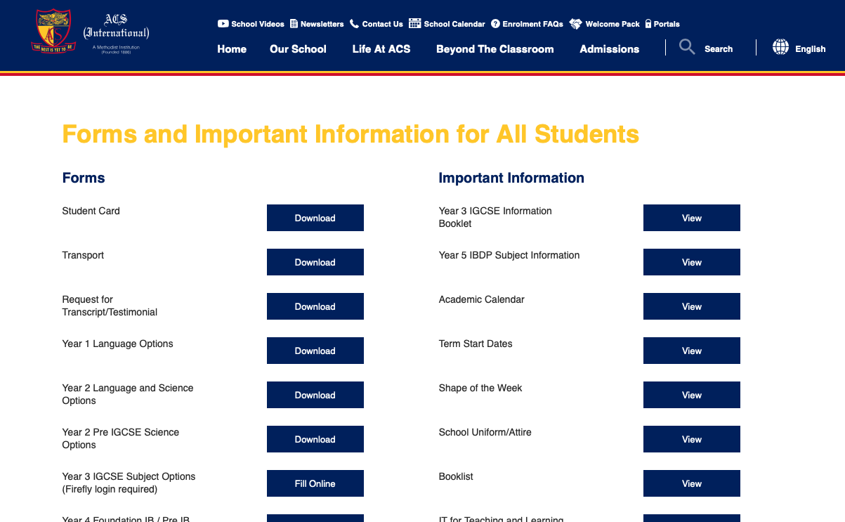
Information Booklet

Slide 35
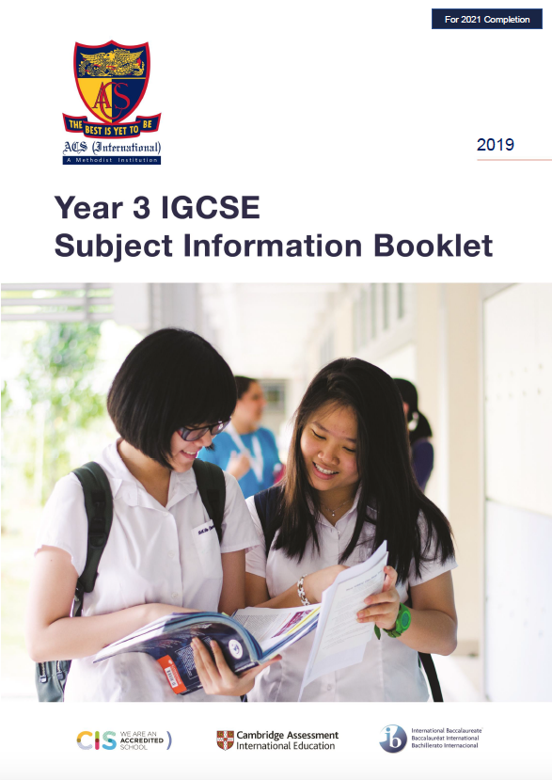
Information Booklet

Slide 36
Selection Process
The subject selection is submitted online.
Visit the school’s website:
www.acsinternational.edu.sg
And follow the steps on the next slides

Slide 37
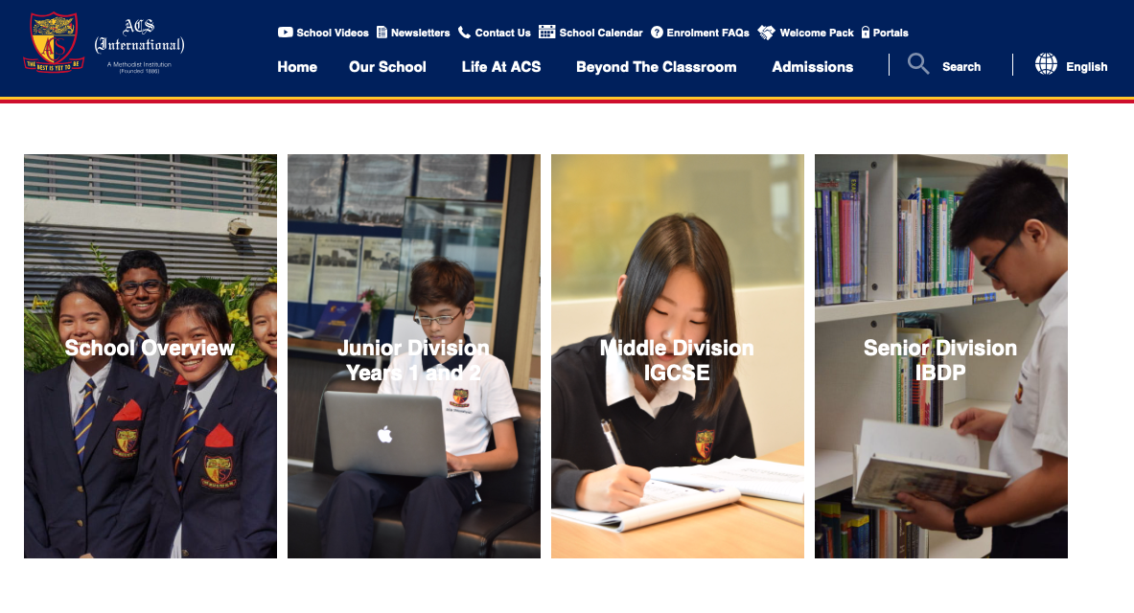
Selection Process

Slide 38
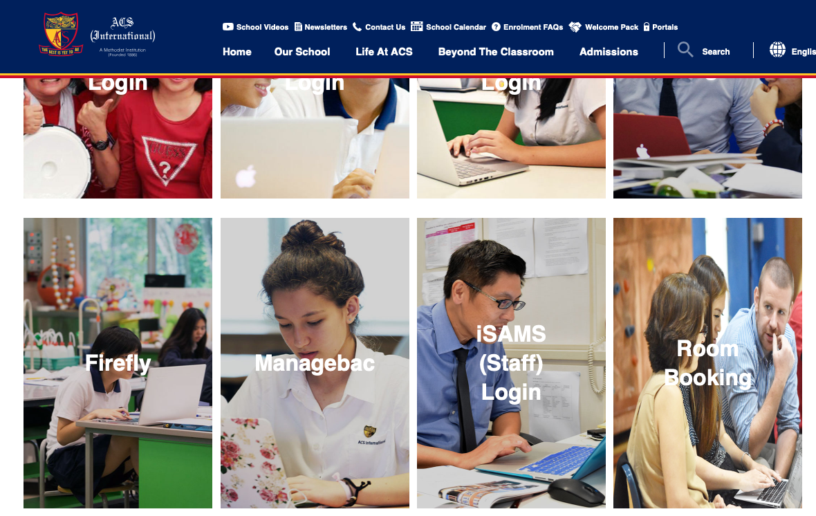
Selection Process

Slide 39
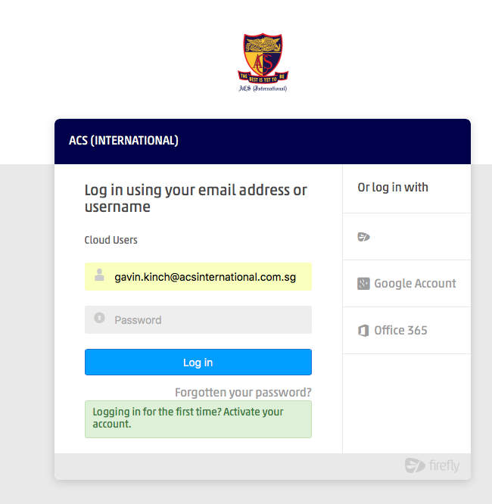
Selection Process

Slide 40
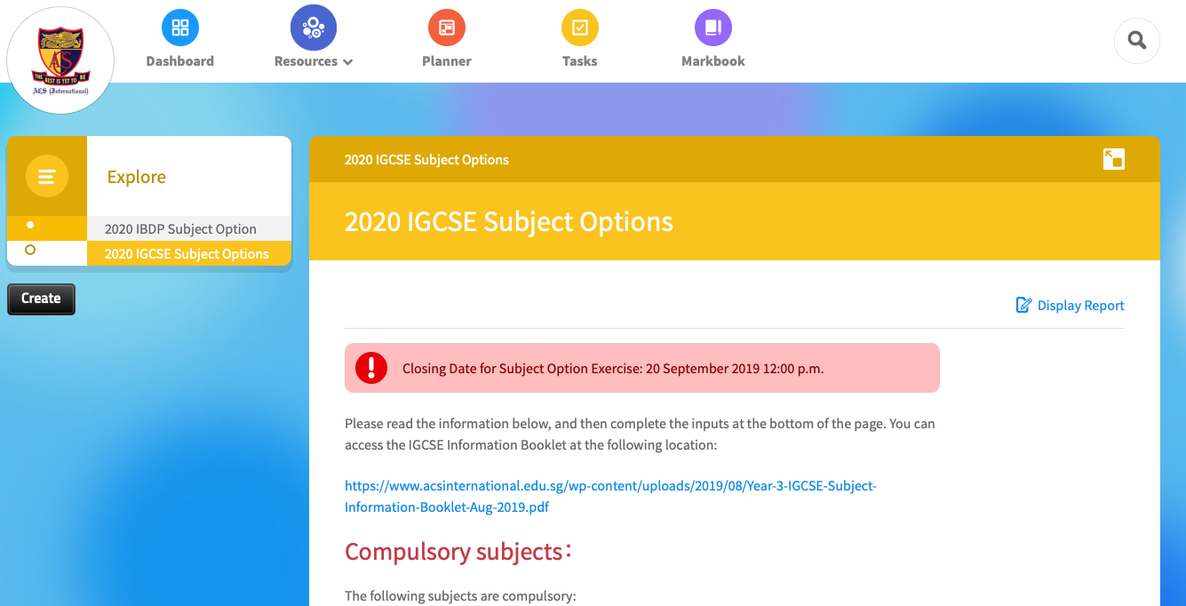
Selection Process

Slide 41
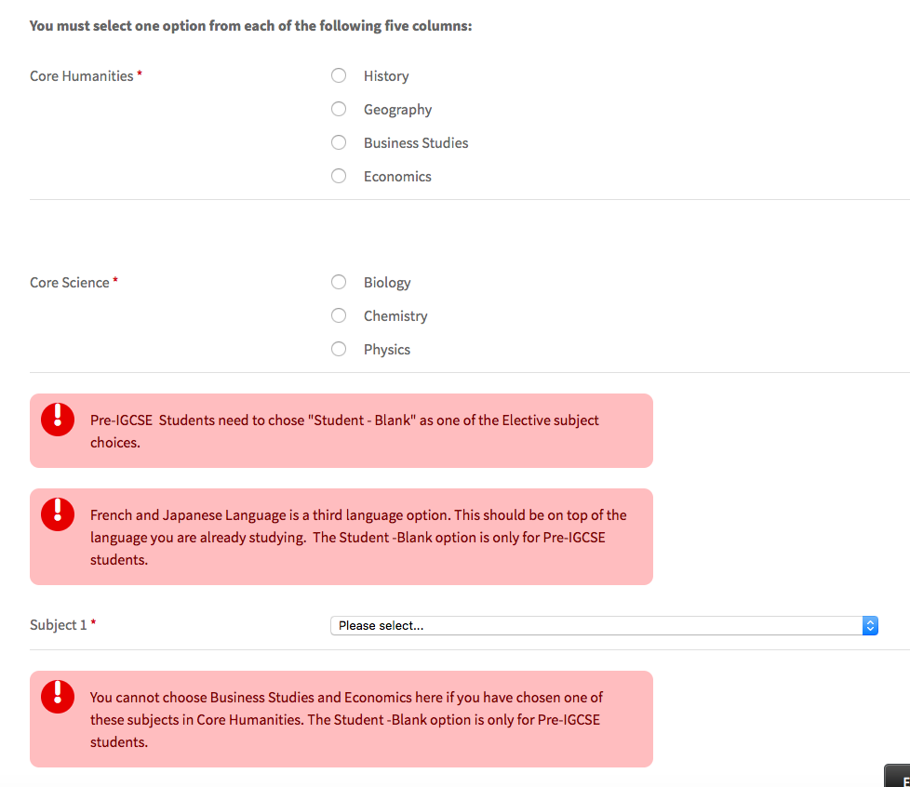
Selection Process

Slide 42
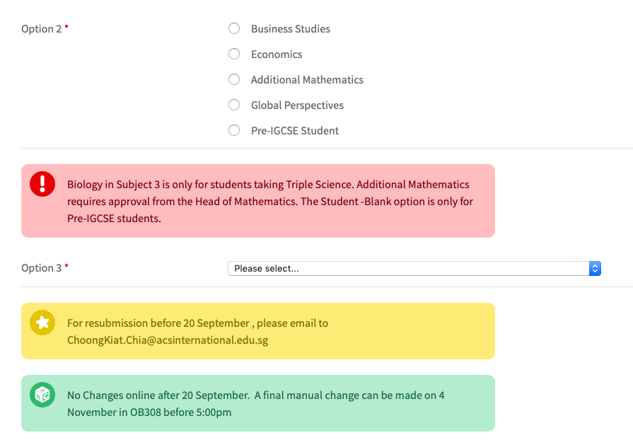
Selection Process

Slide 43
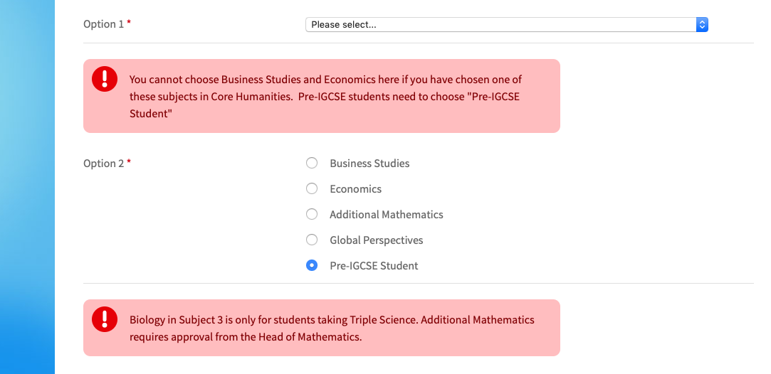
Pre-IGCSE Students

Slide 44
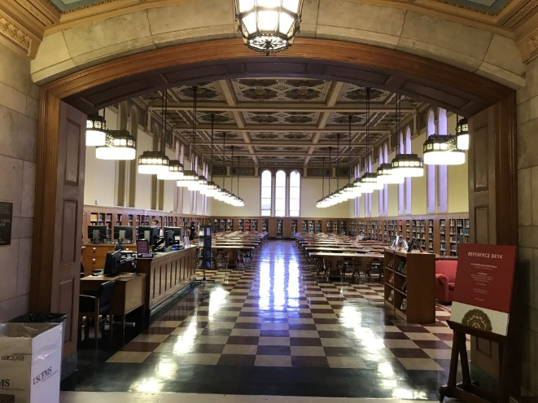
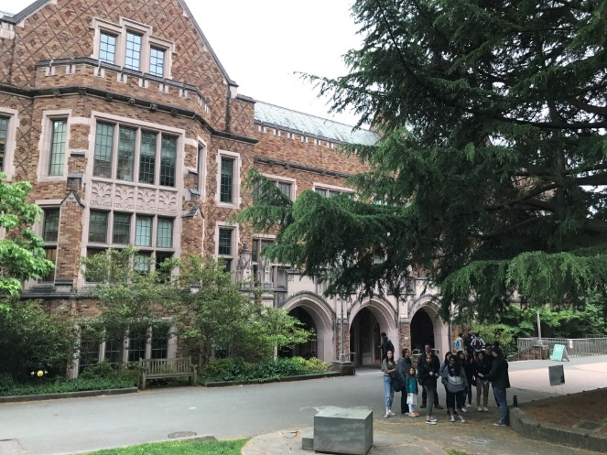
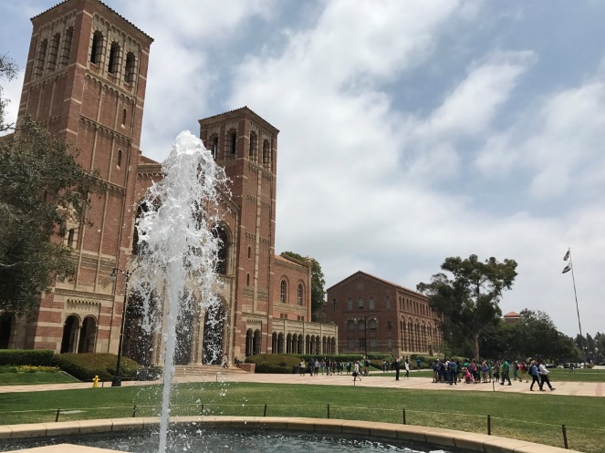
University Considerations
Universities frequently have prerequisite subjects for their degrees.
If you have a strong sense of the area of study you will pursue at university, you
need to check the prerequisite subject list.
Once this is known you can look towards the IBDP subjects you will pick and ensure that your IGCSE choices allow entry into them.

Slide 45
University Considerations
IBDP Entry requirements for popular courses:
Business, Economics or related subjects
Maths – Applications and Interpretation (HL) or (SL).
Economics at the IB level is usually not required.
Engineering
Entry requirements vary significantly.
Maths – Analysis and Approaches(HL) and Physics (HL) are required for some universities.
Maths – Analysis and Approaches(HL) and Chemistry (HL) for chemical engineering,
possibly Physics (HL) or (SL) as well.
Medicine
Chemistry and Biology at (HL)
Physics may be accepted instead of Biology for some courses.
Some programmes have English and/or Maths requirements as well.

Slide 46
University Considerations
Law
There are usually no requirements, however First Language English at (HL or SL)
is recommended.
Occupational Therapy/Physiotherapy
Students would be expected to have Maths and at least one Science at (SL) level.
Psychology, Science or related subjects
More than one HL Science subject and/or Maths SL may be required.
Architecture
Maths and/or Physics at (HL) may be required.
May not be required but may be useful for creating a portfolio of work.
Science related courses
Chemistry HL (preferred) or SL is required for many Science courses.

Slide 47
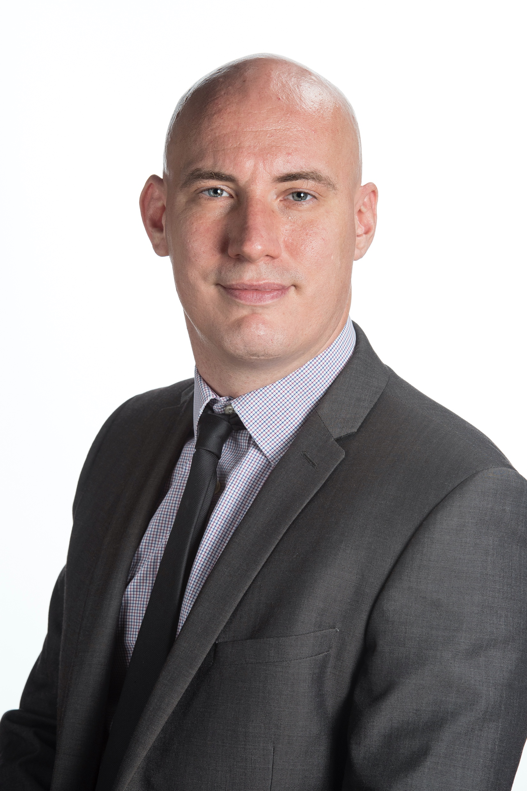
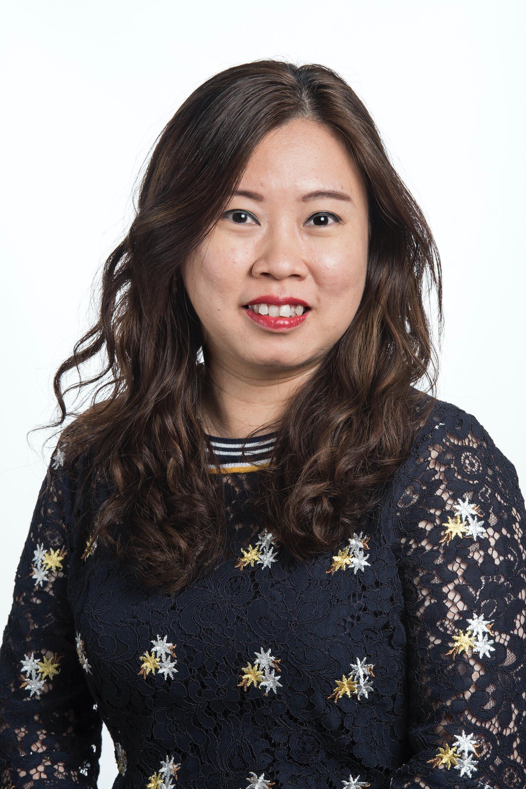
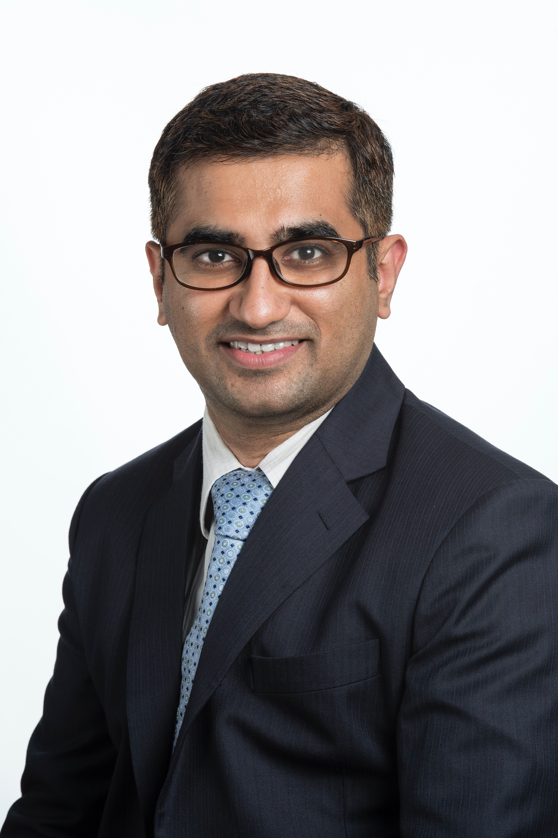
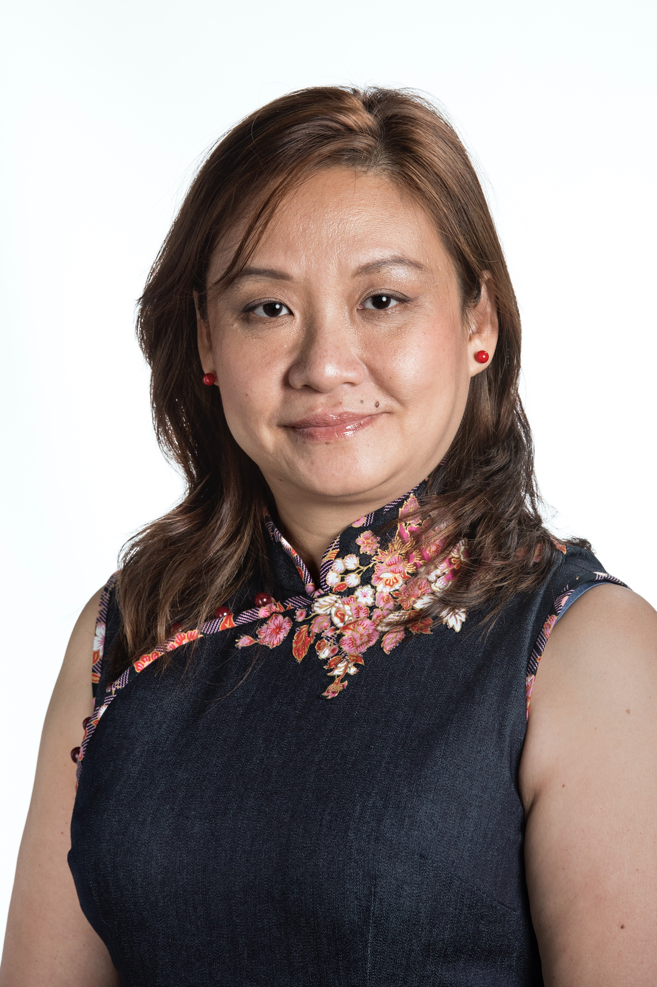
Head of Faculty
Mr Thompson– peter.thompson@acsinternational.edu.sg
English
Mdm Ong– susan.ong@acsinternational.edu.sg
Science
Mr Raghu– Raghu.pc@acsinternational.edu.sg
Mathematics
Mdm Chang– hungtho.chang@acsinternational.edu.sg
The Arts

Slide 48
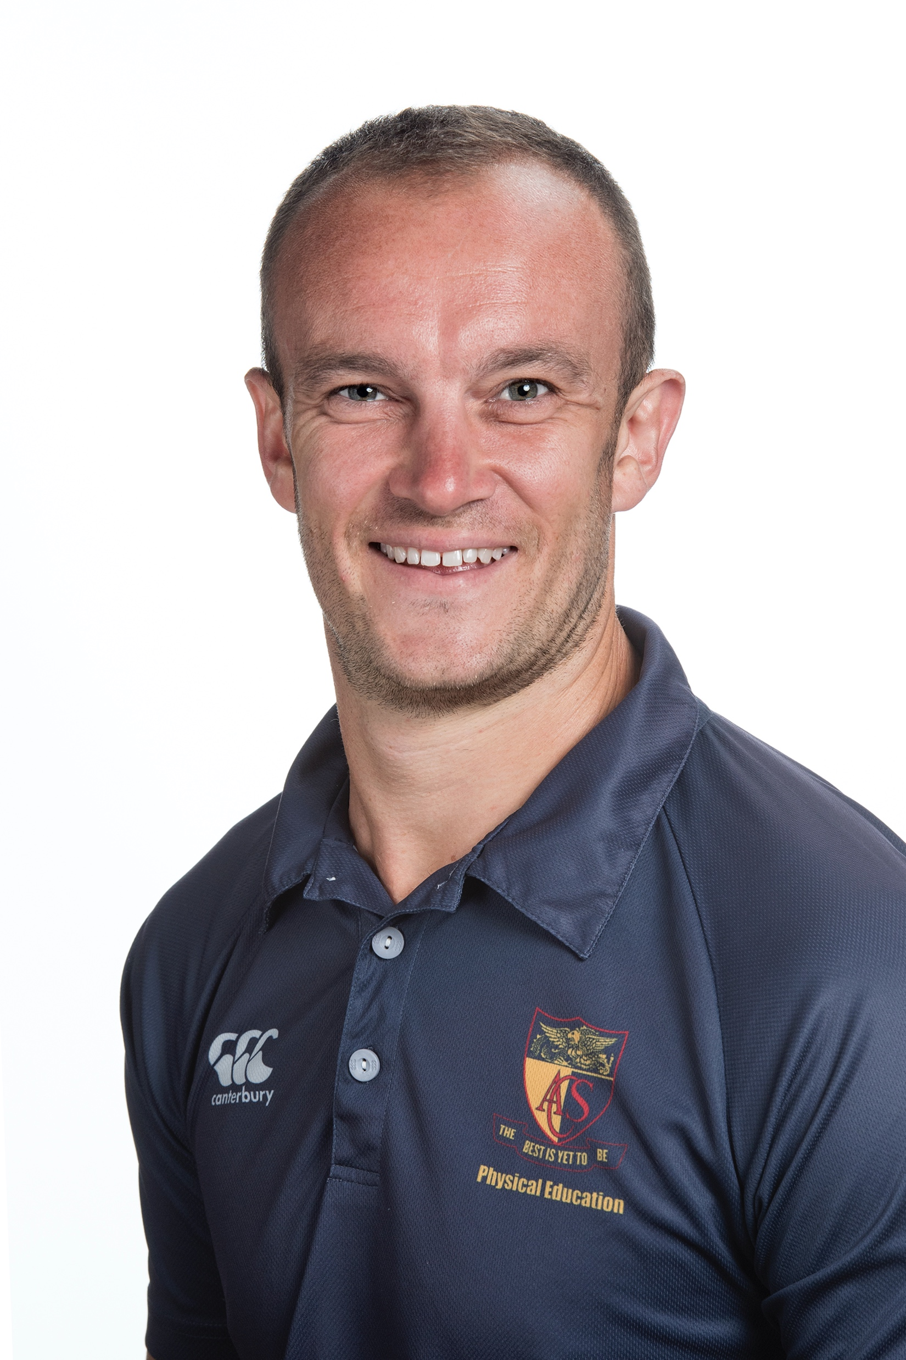
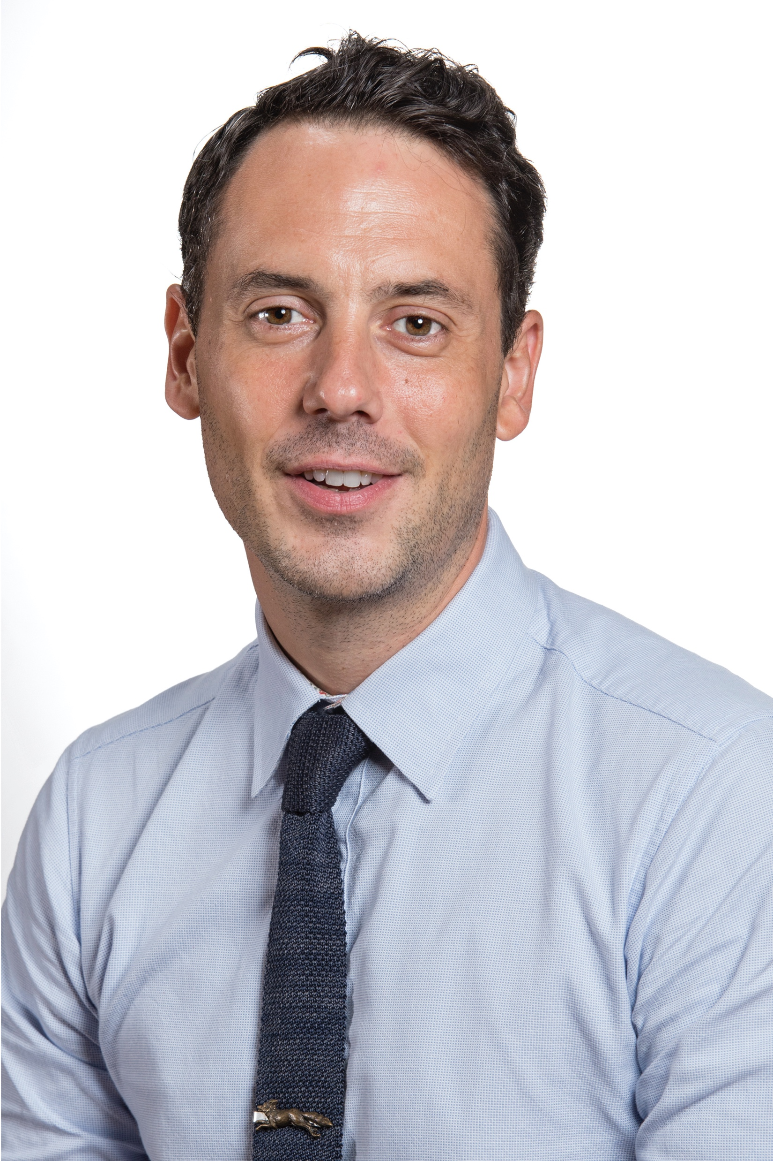
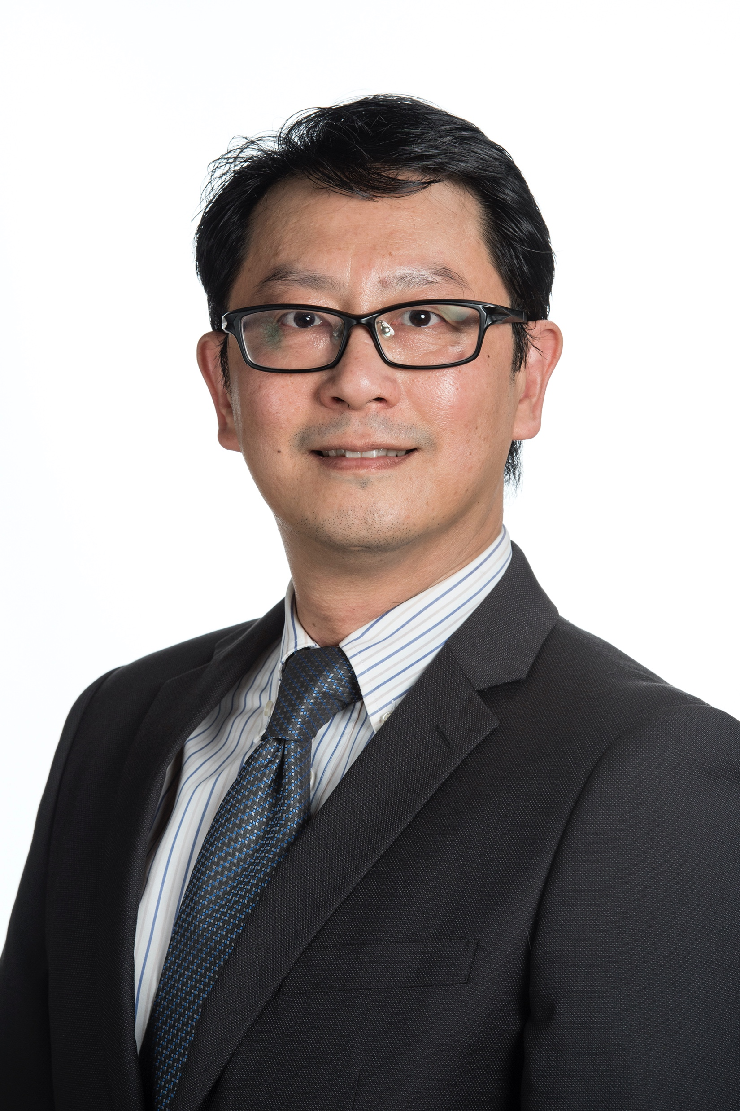
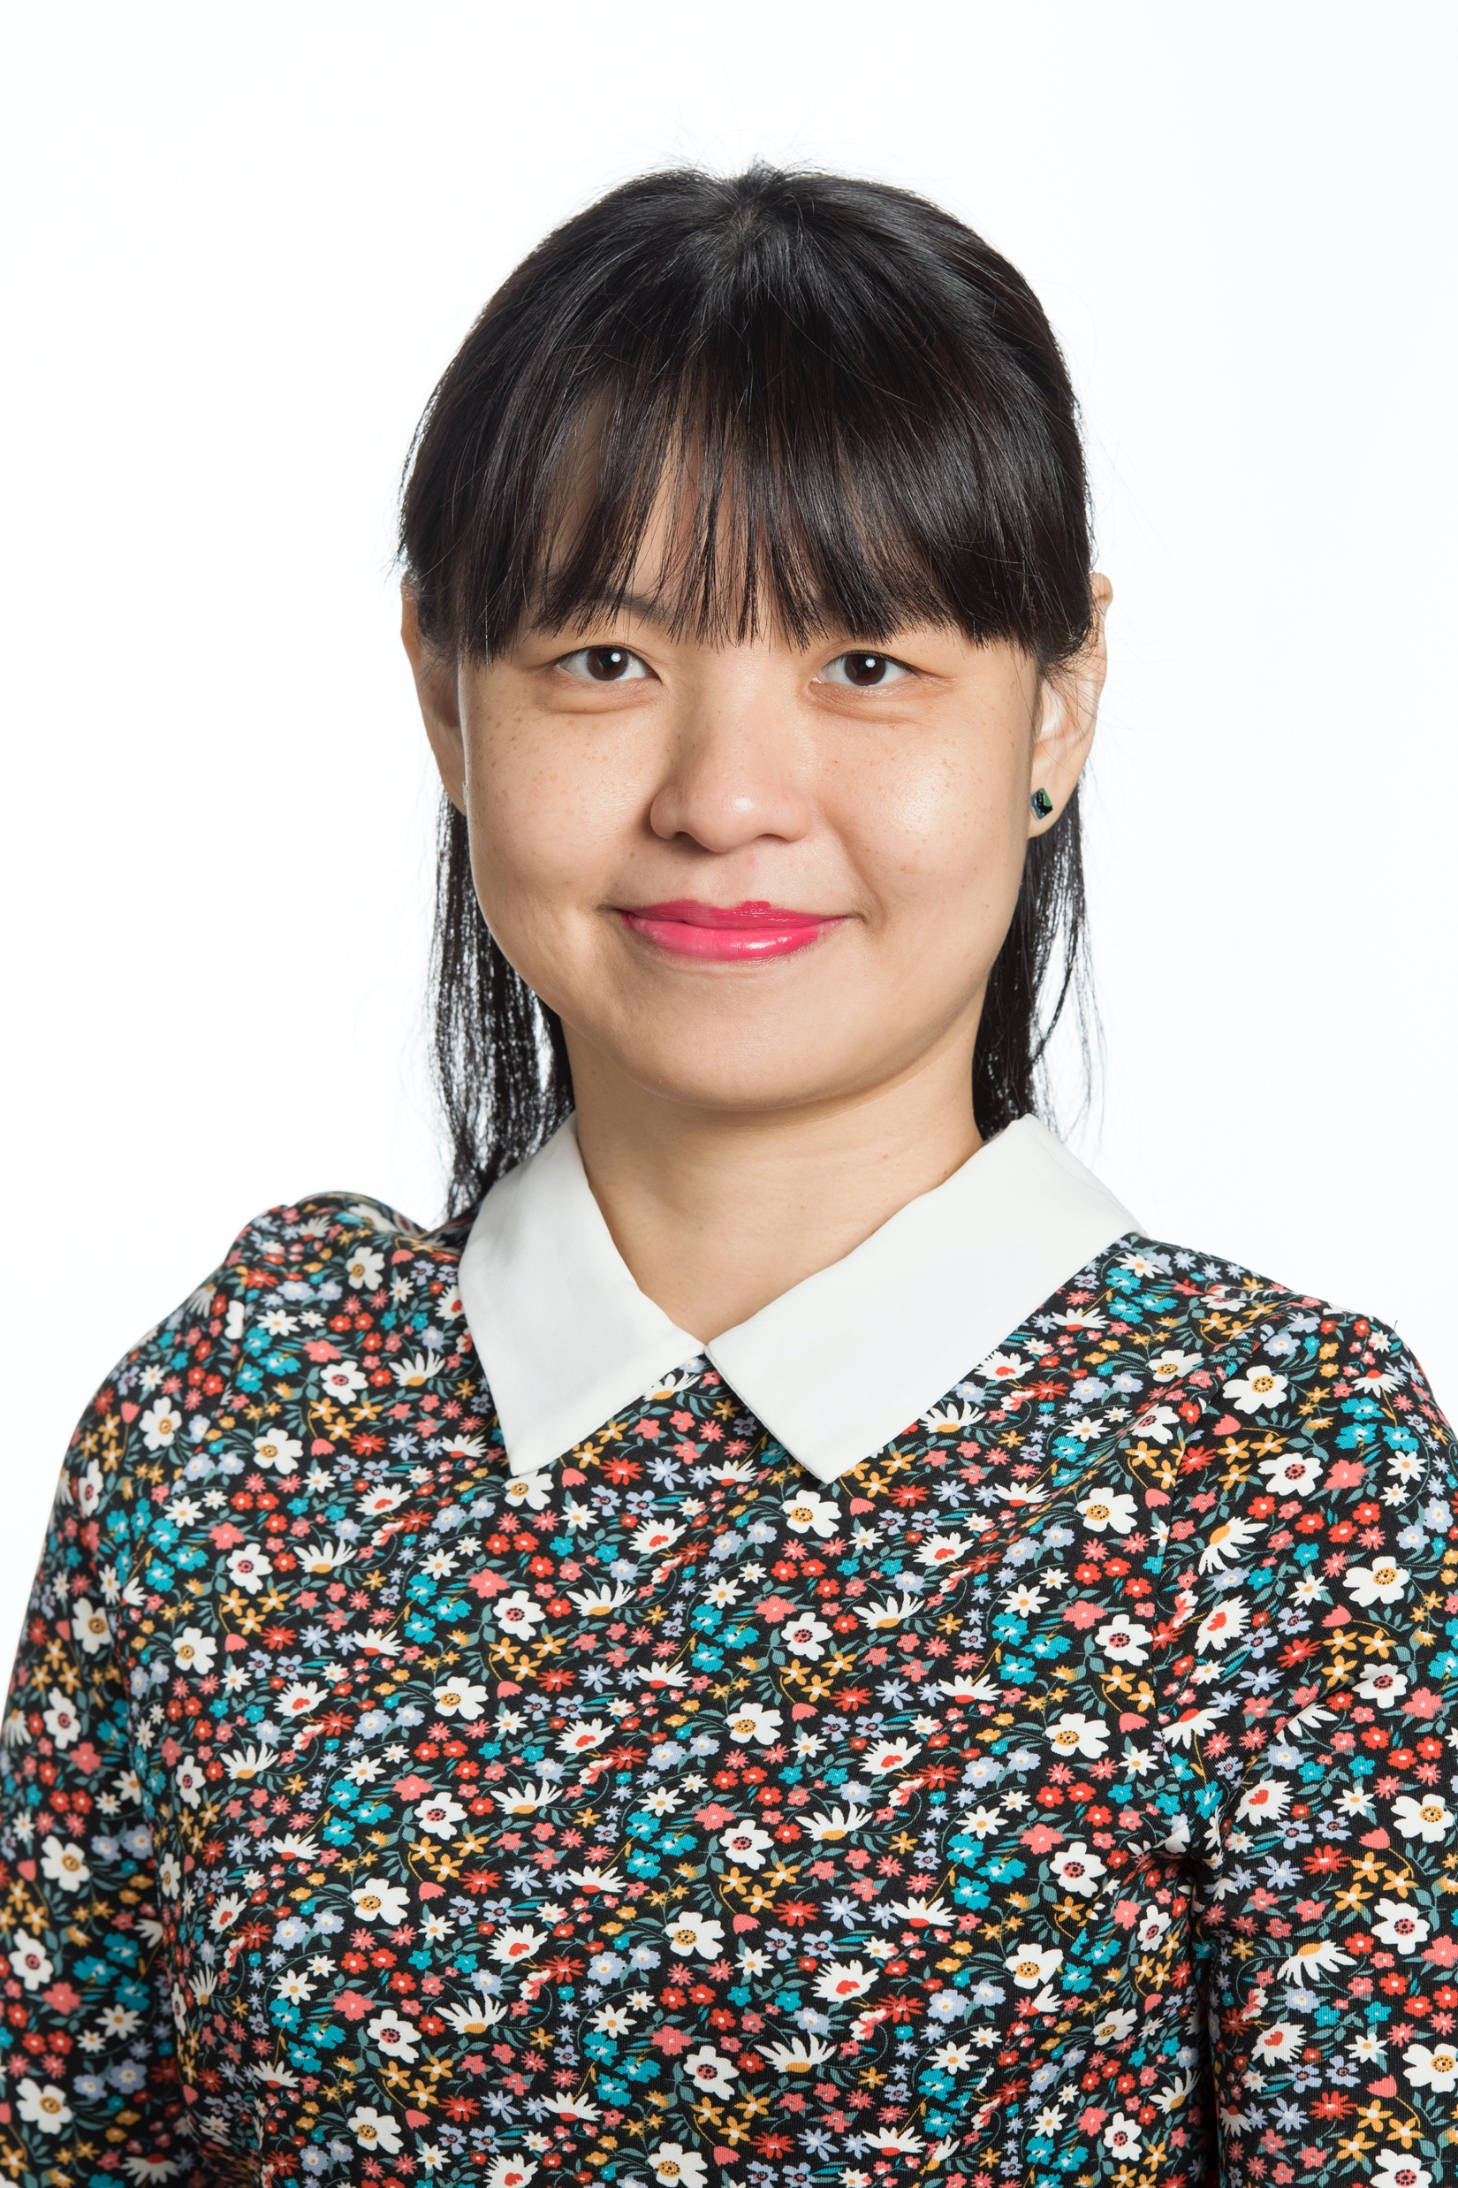
Head of Faculty
Mr Patterson– Michael.patterson@acsinternational.edu.sg
Physical Education
Mr Bossan – chris.bossan@acsinternational.edu.sg
ESOL
Mr Chan– tien.chan@acsinternational.edu.sg
Humanities
Mr Koh– lengkhim.koh@acsinternational.edu.sg
Languages

Slide 49
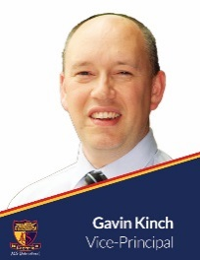
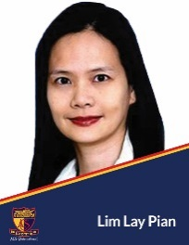
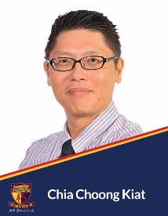
Key Contacts
Gavin Kinch – gavin.kinch@acsinternational.edu.sg
Vice-Principal – Middle Division
Pamela Ng – pamela.ng@acsinternational.edu.sg
Division Coordinator– Middle Division
Lim Lay Pian – laypian.lim@acsinternational.edu.sg
Division Coordinator– Junior Division
Chia Choong Kiat – choongkiat.chia@acsinternational.edu.sg
Director of Administration

Slide 51
How many subjects do I need to take for IGCSE Exams
in 2022?
Mainstream English students take 8 subjects, excluding core PE.
ESOL students take 7 subjects, excluding core PE.

Slide 52
FAQ
Can I ‘trial’ a subject and change it later when I find it difficult?
You will need to think through your choices carefully as there will be no further changes allowed once you start Year 3 in 2021.
Most subjects will be a challenge as you embark on your IGCSE program. The content and skills for IGCSE will need to be gradually learnt over the two years and it is important that you do not give up. A positive attitude will be help you manage your studies and progress well.
It is advisable to speak to your current teachers now to identify your strengths in certain subjects in order to select subjects that you can manage.

Slide 53
FAQ
I am not sure what subjects to choose.
Choices of subjects should be dependent on your strengths, and your future academic pathway. (IB, University)
If you are keen in sciences, choosing to do two sciences will be recommended.
If you are keen in humanities, choosing to do two humanities subjects will be recommended.
You should not be selecting subjects based on your friends’ preferences or whoever is your favorite teacher.

Slide 54
FAQ
What if I am struggling in a subject when I start year 3? What can I do?
It is normal to struggle in the initial few months of Year 3. The move to Year 3 from Year 2 will mean heavier content, more homework and better time management.
It is advisable to speak to your House Tutor or House Master early if you find yourself struggling.
Please approach your subject teachers as well. They will help you to manage your studies through regular support sessions on Tuesdays and Wednesdays.

Slide 55
Important Dates
12 August
Subject options online submission opens
18 September (12:00pm)
Subject options online submission closes
11 November
One day option to change subjects
You must go to OB308 before 5pm
18 November
Receipt of 2020 subject choices

Slide 56
Further Questions
General Questions: gavin.kinch@acsinternational.edu.sg
Language Questions: lengkhim.koh@acsinternational.edu.sg
Technical (Firefly) Questions: choongkiat.chia@acsinternational.edu.sg

